Slide 1
Exploratory Test Automation
Cem Kaner, J.D., Ph.D.
Executive Vice-President, Association for Software Testing
Professor of Software Engineering, Florida Institute of Technology
October, 2009
Copyright (c) Cem Kaner 2009
These notes are partially based on research that was supported by NSF Grant CCLI-0717613 “Adaptation & Implementation of an Activity-Based Online or Hybrid Course in Software Testing.” Any opinions, findings and conclusions or recommendations expressed in this material are those of the author(s) and do not necessarily reflect the views of the National Science Foundation.

Slide 2
Introduction & Overview

Slide 3
Commodity-Level Software Testing
You are a commodity if:
your client perceives you as equivalent to the other members of your class
Commodity testers:
have standardized skills / knowledge
are easily replaced
are cheaply outsourced
add relatively little to the project
Commodities
There are green bananas
and ripe bananas
and rotten bananas
and big bananas
and little bananas.
But by and large,
a banana is a banana.
Commodity testers have little on-the-job control over their pay, status, job security, opportunity for professional growth or the focus of their work.

Slide 4
What level are you working at? (Some Examples)
CHECKING | Testing for UI implementation weakness (e.g. boundary tests) Straightforward nonconformance testing Verification should be thought of as the handmaiden to validation
BASIC EXPLORATION | Quicktests Straightforward tours to determine the basics of the product, the platform, the market, the risks, etc. Here, we are on the road to validation (but might not be there yet)
SYSTEMATIC VARIATION | Conscious, efficiently-run sampling strategy for testing compatibility with big pool of devices / interoperable products / data-sharing partners, etc. Conscious, efficiently-run strategy for assessing data quality, improving coverage (by intentionally-defined criteria)
BUSINESS VALUE | Assess the extent to which the product provides the value for which it was designed, e.g. via exploratory scenario testing
EXPERT INVESTIGATION | Expose root causes of hard to replicate problems Model-building for challenging circumstances (e.g. skilled performance testing) Vulnerabilities that require deep technical knowledge (some security testing) Extent to which the product solves vital but hard-to-solve business problems

Slide 5
GUI-Level Regression Testing: Commodity-Level Test Automation
addresses a narrow subset of the universe of testing tasks
re-use existing tests
a collection of tests that have one thing in common: the program has passed all of them
provide little new information about the product under test
tests are rarely revised to become harsher as the product gets more stable, so the suite is either too harsh for early testing or too simplistic / unrealistic for later testing
tests often address issues (e.g. boundary tests) that would be cheaper and better tested at unit level
enormous maintenance costs
several basic frameworks for reducing GUI regression maintenance are well understood

Slide 6
Table of Contents
A refresher on testing, from an explorer's perspective
define testing / quality / exploration
define the core exploratory skills
Automating exploration?
Why automated regression misses the mark
The agile alternative
Investment modeling as a paradigmatic example
why doesn't this look like testing to you?
Long sequence regression
State models as a vehicle for long-sequence testing
Function equivalence testing
The Telenova simulator: probes as a vehicle for discovery
Generalizing to an architecture
More examples
Summary & conclusions
References

Slide 7
A refresher on testing, from an explorer's perspective:
defining testing / quality / exploration
defining the core exploratory skills

Slide 8
Software testing
is an empirical
technical
investigation
conducted to provide stakeholders
with information
about the quality
of the product or service under test
We design and run tests in order to gain useful information about the product's quality.
Empirical? -- All tests are experiments.
Information? -- Reduction of uncertainty. Read Karl Popper (Conjectures & Refutations) on the goals of experimentation

Slide 9
Testing is always a search for information
Find important bugs, to get them fixed
Assess the quality of the product
Help managers make release decisions
Block premature product releases
Help predict and control product support costs
Check interoperability with other products
Find safe scenarios for use of the product
Assess conformance to specifications
Certify the product meets a particular standard
Ensure the testing process meets accountability standards
Minimize the risk of safety-related lawsuits
Help clients improve product quality & testability
Help clients improve their processes
Evaluate the product for a third party
Different objectives require different testing tools and strategies and will yield different tests, different test documentation and different test results.

Slide 10
Test techniques A test technique is a recipe, or a model, that guides us in creating specific tests. Examples of common test techniques:
Function testing
Specification-based testing
Domain testing
Risk-based testing
Scenario testing
Regression testing
Stress testing
User testing
All-pairs combination testing
Data flow testing
Build-verification testing
State-model based testing
High volume automated testing
Device compatibility testing
Testing to maximize statement and branch coverage
We pick the technique that provides the best set of attributes, given our context and the objective of our search

Slide 11
Example: Domain Testing
In domain testing:
we partition a domain
into sub-domains (equivalence classes)
and then test using values
(best representatives, typically boundaries)
from each sub-domain.

Slide 12
Example: Scenario testing
The ideal scenario has several characteristics:
The test is based on a story about how the program is used, including information about the motivations of the people involved.
The story is motivating. A stakeholder with influence would push to fix a program that failed this test.
The story is credible. It not only could happen in the real world; stakeholders would believe that something like it probably will happen.
The story involves a complex use of the program or a complex environment or a complex set of data.
The test results are easy to evaluate. This is valuable for all tests, but is especially important for scenarios because they are complex.
Notes:
Anyone affected by a program is a stakeholder. A person who can influence development decisionsis a stakeholder with influence.

Slide 13
Techniques differ in how to define a good test
Power. When a problem exists, the test will reveal it
Valid. When the test reveals a problem, it is a genuine problem
Value. Reveals things your clients want to know about the product or project
Credible. Client will believe that people will do the things done in this test
Representative of events most likely to be encountered by the user
Non-redundant. This test represents a larger group that address the same risk
Motivating. Your client will want to fix the problem exposed by this test
Maintainable. Easy to revise in the face of product changes
Repeatable. Easy and inexpensive to reuse the test.
Performable. Can do the test as designed
Refutability: Designed to challenge basic or critical assumptions (e.g. your theory of the user’s goals is all wrong)
Coverage. Part of a collection of tests that together address a class of issues
Easy to evaluate.
Supports troubleshooting. Provides useful information for the debugging programmer
Appropriately complex. As a program gets more stable, use more complex tests
Accountable. You can explain, justify, and prove you ran it
Cost. Includes time and effort, as well as direct costs
Opportunity Cost. Developing and performing this test prevents you from doing other work

Slide 14
Differences in emphasis: Examples
Domain testing
Focused on non-redundancy, validity, power, and variables-coverage. Tests are typically highly repeatable, simple, and should be easy to maintain.
Not focused on representativeness, credibility, or motivational effect.
Scenario testing
Focused on validity, complexity, credibility, and motivational effect.
Not focused on power, maintainability, or coverage.
“Not focused” doesn’t mean, “never is.” It means that this is a factor that we don’t treat as critical in developing or evaluating this type of test.

Slide 15
Testing is always done within a context
We test in the face of harsh constraints
Complete testing is impossible
Project schedules and budget are finite
Skills of the testing group are limited
Testing might be done before, during or after a release.
Improvement of product or process might or might not be an objective of testing.
We test on behalf of stakeholders
Project manager, marketing manager, customer, programmer, competitor, attorney
Which stakeholder(s) this time?
What information are they interested in?
What risks do they want to mitigate?
As service providers, it is our task to learn (or figure out) what services our clients want or need this time, and under these circumstances.

Slide 16
Examples of context factors that drive and constrain testing
Who are the stakeholders with influence
What are the goals and quality criteria for the project
What skills and resources are available to the project
What is in the product
How it could fail
Potential consequences of potential failures
Who might care about which consequence of what failure
How to trigger a fault that generates a failure we're seeking
How to recognize failure
How to decide what result variables to attend to
How to decide what other result variables to attend to in the event of intermittent failure
How to troubleshoot and simplify a failure, so as to better
motivate a stakeholder who might advocate for a fix
enable a fixer to identify and stomp the bug more quickly
How to expose, and who to expose to, undelivered benefits, unsatisfied implications, traps, and missed opportunities.

Slide 17
What are we really testing for?
Quality is value to some person
-- Jerry Weinberg
Quality is inherently subjective
Different stakeholders will perceive
the same product
as having
different levels of quality
Testers look for
different things …
… for different stakeholders

Slide 18
Software error (aka bug)
An attribute of a software product
that reduces its value to a favored stakeholder
or increases its value to a disfavored stakeholder
without a sufficiently large countervailing benefit.
An error:
May or may not be a coding error, or a functional error
Any threat to the
value of the product
to any stakeholder
who matters.
James Bach

Slide 19
Not every limitation of value is a bug
American crash standards say that a car is defective if it gets damaged in a head-on 5 mph collision.
Is a car defective if it can’t withstand a 40 mph crash into a brick wall?
We DO know how to make motor vehicles that can withstand collisions at much higher speeds.

Slide 20
Not every limitation on value is a bug.
Effective bug reporting requires judgment, based on evaluation of the product's context and appropriate constraints within that context.

Slide 21
Validation, Accreditation, Verification
Validation:
Will this software meet our needs?
Accreditation:
Should I certify this software as adequate for our needs?
Verification (at the system level)
Does this software conform to documented assertions?
In contract-driven development, verification can tell you that the client is now legally obligated to pay for the software.
Verification cannot tell you whether the software will meet stakeholder needs or elicit a positive reaction from users.

Slide 22
Validation, Accreditation, Verification
At the system level,
verification is about confirming that you are testing what you think you are testing
validation and accreditation are about evaluating the quality of the product

Slide 23
System testing (validation)
Designing system tests is like doing a requirements analysis. They rely on similar information but use it differently.
Requirements analysts try to foster agreement about the system to be built. Testers exploit disagreements to predict problems with the system.
Testers don’t have to decide how the product should work. Their task is to expose credible concerns to the stakeholders.
Testers don’t have to make product design tradeoffs. They expose consequences of those tradeoffs, especially unanticipated or serious consequences.
The tester doesn’t have to respect prior design agreements.
The system tester’s work cannot be exhaustive, just useful

Slide 24
Reject the “Not My Job” definition of testing
Testing is not only about doing tasks some programmer can imagine for you or meeting objectives some programmer wishes on you
unless that programmer is your primary stakeholder
The tester who looks only for coding errors misses all the other ways in which a program is of lower quality than it should be.
Anything that threatens a product’s value to a stakeholder with influence threatens quality in a way important to the project.
You might be asked to investigate any type of threat, including security, performance, usability, suitability, etc.
Tasks beyond your personal skill set may still be within your scope.

Slide 25
Exploratory Testing: Testing is an Adaptive, Skilled, Cognitively Complex Activity

Slide 26
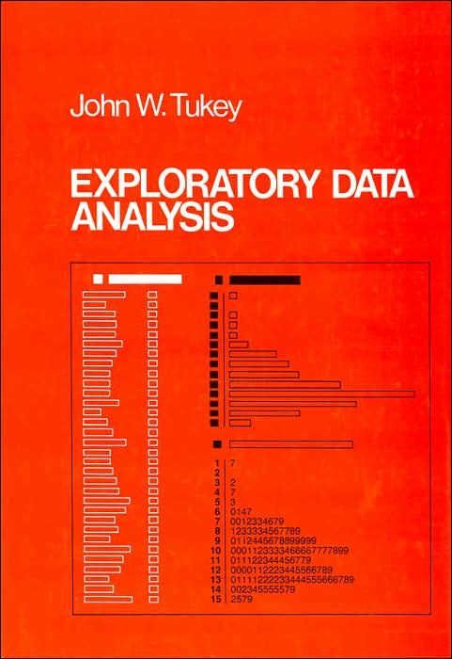
I coined the phrase “exploratory testing” in 1983 to describe the practice of some of the best testers in Silicon Valley.
People sometimes ask about the distinction between ET and "Ad-Hoc Testing." My intent was to emphasize the skill, intentionality, and learning that is at the core of exploration.
"Exploratory data analysis (EDA) is an approach to analyzing data for the purpose of formulating hypotheses worth testing, complementing the tools of conventional statistics for testing hypotheses. It was so named by John Tukey to contrast with Confirmatory Data Analysis, the term used for the set of ideas about hypothesis testing, p-values, confidence intervals etc. which formed the key tools in the arsenal of practicing statisticians at the time."
en.wikipedia.org/wiki/Exploratory_data_analysis

Slide 27
Some key points
ET is an approach to testing, not a technique
You can use any test technique in an exploratory way or a scripted way
You can work in an exploratory way at any point in testing
Effective testing requires the application of knowledge and skill
This is more obvious (but maybe not more necessary) in the exploratory case
Training someone to be an explorer probably involves greater emphasis on higher levels of knowledge

Slide 28
Exploratory software testing
is a style of software testing
that emphasizes the personal freedom and responsibility
of the individual tester
to continually optimize the value of her work
by treating
test-related learning,
test design,
test execution, and
test result interpretation
as mutually supportive activities
that run in parallel throughout the project.

Slide 29
Some common misunderstandings...
No, ET is not only manual testing. Explorers can use any tools they want.
No, ET is not only black box. Explorers can work with the program at any level, using any information.
No, ET is not only test execution. Sometimes explorers beat on the keyboard or do standardized “attacks” (quicktests), but explorers often develop tests and strategies with studies of the product, the platform, the market and other risks.
No, ET is not completely undocumented. Explorers create whatever documents are useful for their purposes....
Including checklists.
But (almost) never scripts.

Slide 30
Starting Point: The need for judgment
We often talk about testing as a process of comparing empirical results to expected results
But even the basic process of comparison requires human judgment, based on an understanding of the problem domain

Slide 31
A program can fail in many ways Based on notes from Doug Hoffman
Program state
Program state, including uninspected outputs
System
under
test
System state
System state
Intended inputs
Monitored outputs
Configuration and
system resources
Impacts on connected
devices / system resources
From other cooperating
processes, clients or servers
To other cooperating
processes, clients or servers

Slide 32
The oracle problem and test automation
We often hear that most (or all) testing should be automated.
Automated testing depends on our ability to programmatically detect when the software under test fails a test.
Our ability to automate testing is fundamentally constrained by our ability to create and use oracles.

Slide 33
Automated comparison is heuristic
False alarms:
Word vs. WordPad mismatches might be appropriate or might not matter.
Big problem for automated regression tests (compare old to new versions). Design changes causes mismatches—we must spend time fixing the tests.
Missed bugs:
Word vs. WordPad matches might result from the same error in both.
Automated comparison-based testing is subject to false alarms and misses. Automate or not, you must still exercise judgment in picking risks to test against and interpreting the results.

Slide 34
Comparison Oracles have the same problems Based on notes from Doug Hoffman
System
under
test
Program state, (and uninspected outputs)
Program state
System state
System state
Monitored outputs
Intended inputs
Impacts on connected devices / resources
Configuration and system resources
To cooperating processes, clients or servers
Cooperating processes, clients or servers
Program state
Program state, (and uninspected outputs)
System state
Reference
function
System state
Intended inputs
Monitored outputs
Configuration and system resources
Impacts on connected devices / resources
Cooperating processes, clients or servers
To cooperating processes, clients or servers

Slide 35
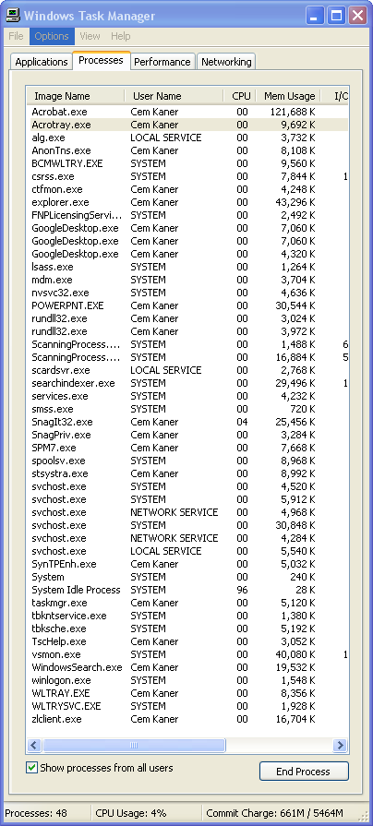
Can you specify your test configuration?
Comparison to a reference function is fallible. We only control some inputs and observe some results (outputs).
For example, do you know whether test & reference systems are equivalently configured?
Does your test documentation specify ALL the processes running on your computer?
Does it specify what version of each one?
Do you even know how to tell:
What version of each of these you are running?
When you (or your system) last updated each one?
Whether there is a later update?

Slide 36
A program can fail in many ways
1100 embedded diagnostics
Even if we coded checks for each of these, the side effects (data, resources, and timing) would provide us a new context for Heisenberg uncertainty.
Our tests cannot practically address all of the possibilities

Slide 37
Inattentional blindness Demonstration / Discussion
http://viscog.beckman.uiuc.edu/djs_lab/demos.html
http://www.geekarmy.com/Science/Crazy-Vision-Test.html
http://www.dothetest.co.uk/

Slide 38
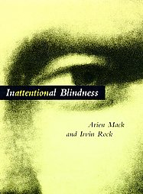
Inattentional blindness
What is important about inattentional blindness is NOT
Selective attention
(we’ve known about that for years and years and years)
It is that IB demonstrates:
pre-attentive
semantically-based
filtering
This means that we ignore things based on their meaning, before we ever become aware of them. As applied to testing, it is unreasonable to give someone a script, tell them to pay attention to specific issues of interest, and expect them to notice other failures.

Slide 39
Oracles
An oracle is the principle or mechanism by which you recognize a problem.
“..it works”
really means...
“...it appeared to meet some requirement to some degree.”

Slide 40
Does font size work in Open Office? What’s your oracle?

Slide 41
OK, so what about WordPad?

Slide 42
Compare WordPad to Word? They look pretty similar, no?
WordPad
Word

Slide 43
Make the comparison easier Highlighting makes relative sizes more obvious
WordPad
Word

Slide 44
Now that we see a difference …
… Is it a difference that makes a difference?
The oracle problem highlights the fundamental role of judgment in testing.
Testing is a cognitive activity
Not a mechanical activity.

Slide 45
Risk as a simplifying factor
For Wordpad, we don’t care if font size meets precise standards of typography!
In general it can vastly simplify testing if we focus on whether the product has a problem that matters, rather than whether the product merely satisfies all relevant standards.
Effective testing requires that we understand standards as they relate to how our clients value the product.
Instead of thinking about pass vs. fail,
Consider thinking problem vs. no problem.

Slide 46
Risk as a simplifying factor
What if we applied the same evaluation approach
that we applied to WordPad
to Open Office or MS Word or Adobe PageMaker?
In risk-based testing,
we choose the tests that we think are
the most likely to expose a
serious problem,
and skip the tests that we think are
unlikely to expose a problem, or
likely to expose problems that
no one would care about.
The same evaluation criteria lead to different conclusions in different contexts

Slide 47
So, what are we testing for?
What to cover?
Every font size (to a tenth of a point).
Every character in every font.
Every method of changing font size.
Every user interface element associated with font size.
Interactions between font size and other contents of a document.
Interactions between font size and every other feature.
Interactions between font sizes and graphics cards & modes.
Print vs. screen display.

Slide 48
What evaluation criterion?
What do you know about typography?
Definition of “point” varies. There are at least six different definitions
(http://www.oberonplace.com/dtp/fonts/point.htm)
Absolute size of characters can be measured, but not easily
(http://www.oberonplace.com/dtp/fonts/fontsize.htm)
How closely must size match to the chosen standard?
Heuristic approaches, such as:
relative size of characters
comparison to MS Word
expectations of different kinds of users for different uses.
Testing is about ideas. Heuristics give you ideas.

Slide 49
Comparison to a heuristic predictor
A heuristic is a fallible idea or method that may you help simplify and solve a problem.
Heuristics can hurt you when used as if they were authoritative rules.
Heuristics may suggest wise behavior, but only in context. They do not contain wisdom.
Your relationship to a heuristic is the key to applying it wisely.
“Heuristic reasoning is not regarded as final and strict but as provisional and plausible only, whose purpose is to discover the solution to the present problem.”
- George Polya, How to Solve It

Slide 50
Billy V. Koen Definition of the Engineering Method (ASEE)
“A heuristic is anything that provides a plausible aid or direction in the solution of a problem but is in the final analysis unjustified, incapable of justification, and fallible. It is used to guide, to discover, and to reveal.
“Heuristics do not guarantee a solution.
“Two heuristics may contradict or give different answers to the same question and still be useful.
“Heuristics permit the solving of unsolvable problems or reduce the search time to a satisfactory solution.
“The heuristic depends on the immediate context instead of absolute truth as a standard of validity.”
Koen (p. 70) offers an interesting definition of engineering “The engineering method is the use of heuristics to cause the best change in a poorly understood situation within the available resources”

Slide 51
Some useful oracle heuristics
Consistent within product: Function behavior consistent with behavior of comparable functions or functional patterns within the product.
Consistent with comparable products: Function behavior consistent with that of similar functions in comparable products.
Consistent with history: Present behavior consistent with past behavior.
Consistent with our image: Behavior consistent with an image the organization wants to project.
Consistent with claims: Behavior consistent with documentation or ads.
Consistent with specifications or regulations: Behavior consistent with claims that must be met.
Consistent with user’s expectations: Behavior consistent with what we think users want.
Consistent with Purpose: Behavior consistent with product or function’s apparent purpose.

Slide 52
Exploration Using Checklists

Slide 53
Exploration using Checklists
Exploratory testing is a general approach to testing, including all aspects of product/market research, test design, execution, troubleshooting, result reporting, etc.
To see what is different about exploratory testing, contrast it with its opposite, scripted testing. In practice, most testing that people actually do probably sits in the middle, somewhere between pure exploration and perfect scripting.
My bias is that most of the best testing sits a lot closer to the exploratory side of that continuum. And yet, I tell people they should use checklists to structure their work. How can that be? Aren't checklists really just abbreviated scripts?
As a law student, and then as a lawyer, I relied heavily on detailed checklists and task outlines and templates for forms, but we were trained to use them as aids to critical thinking in the moment, rather than as directives to be followed. This talk considers that distinction, and how it has helped me approach many testing tasks in a way that provides structure but doesn't restrict exploration.

Slide 54
Background
http://www.newyorker.com/reporting/2007/12/10/071210fa_fact_gawande
http://www.nytimes.com/2008/01/22/health/22brod.html
Specific examples seemed straightforward, not very complex, like bug advocacy RIMGEA, but popular press can’t be too complex.
Reports of the value of medical checklists carried into blog / email discussions of the value of scripts and risks of exploratory testing.

Slide 55
Checklists ≠ Scripts
Reports of the value of medical checklists carried into blog / email discussions of the value of scripts and the risks of (unscripted) exploratory testing.
I’m not a doctor -- I can’t speak to medical checklists.
But the descriptions in the articles looked to me more like legal checklists than software testing scripts.
I am a lawyer, and I can say with confidence that in THAT field:
Checklists are tremendously valuable and lawyers would often be fools not to use them
But checklists are NOT scripts
Checklists like the ones used by lawyers are entirely compatible with exploratory testing—explorers often do and often should use checklists to guide and track their work.

Slide 56
What are scripts?
I keep hearing that
scripts are “best practices” and that
following standards that push scripted testing is the “professional” approach to testing.

Slide 57
Scripted testing
A script specifies
test entry conditions
test operations
expected results
comparisons the human or machine should make
Scripts can control
manual testing by humans
automated test execution or comparison by machine

Slide 58
Test Scripts (from the latest IEEE 829)
3.1.41 test case: (A) A set of test inputs, execution conditions, and expected results developed for a particular objective, such as to exercise a particular program path or to verify compliance with a specific requirement. (B) Documentation specifying inputs, predicted results, and a set of execution conditions for a test item. [B2]
3.1.49 test procedure: (A) Detailed instructions for the set-up, execution, and evaluation of results for a given test case. (B) A document containing a set of associated instructions as in (A). (C) Documentation that specifies a sequence of actions for the execution of a test. [B4]
ANSI/IEEE Std P829-2007, July 30, 2007
Draft IEEE Standard for software and system test documentation

Slide 59
Here’s the kind of detail you find in a script
1 __ Pull down the File menu
2 __ Select Print
3 __ The program displays the Print dialog
4 __ Enter 2 in Number of copies
5 __ Enter a check in Collate
Another variation (my style, in the early1980’s):
Step # | Check- mark | What to do | What to see | Design notes | Observation notes
1. | ____ | Pull down the File menu | File menu down | Test author’s comments | Tester’s notes at run-time

Slide 60
Exploratory testing: Interpreting
Learning: Anything that can guide us in what to test, how to test, or how to recognize a problem.
Design: “to create, fashion, execute, or construct according to plan; to conceive and plan out in the mind” (Websters)
Designing is not scripting. The representation of a plan is not the plan.
Explorers’ designs can be reusable.
Execution: Doing the test and collecting the results. Execution can be automated or manual.
Interpretation: What do we learn from program as it performs under our test
about the product and
about how we are testing the product?

Slide 61
Why automated regression misses the mark

Slide 62
Typical Testing Tasks
Analyze product & its risks
benefits & features
risks in use
market expectations
interaction with external S/W
diversity / stability of platforms
extent of prior testing
assess source code
Develop testing strategy
pick key techniques
prioritize testing foci
Design tests
select key test ideas
create tests for each idea
Run test first time (often by hand)
Evaluate results
Troubleshoot failures
Report failures
Manage test environment
set up test lab
select / use hardware/software configurations
manage test tools
Keep archival records
what tests have we run
trace tests back to specs
If we create regression tests:
Capture or code steps once test passes
Save “good” result
Document test / file
Execute the test
Evaluate result
Report failure or
Maintain test case
This contrasts the variety of tasks commonly done in testing with the narrow reach of UI-level regression automation. This list is illustrative, not exhaustive.

Slide 63
Automating system-level testing tasks
No testing tool covers this entire range of tasks
In automated regression testing:
we automate the test execution, and a simple comparison of expected and obtained results
we don’t automate the design or implementation of the test or the assessment of the mismatch of results (when there is one) or the maintenance (which is often VERY expensive).
So, the key design question is, where do we need the most assistance?
"GUI-level automated system testing" doesn't mean automated testing "GUI-level automated system testing" means
computer-assisted testing

Slide 64
Other computer-assistance?
Tools to help create tests
Tools to sort, summarize or evaluate test output or test results
Tools (simulators) to help us predict results
Tools to build models (e.g. state models) of the software, from which we can build tests and evaluate / interpret results
Tools to vary inputs, generating a large number of similar (but not the same) tests on the same theme, at minimal cost for the variation
Tools to capture test output in ways that make test result replication easier
Tools to expose the API to the non-programmer subject matter expert, improving the maintainability of SME-designed tests
Support tools for parafunctional tests (usability, performance, etc.)

Slide 65
Commonplace Testing Practice in Regulated Industries
System-level tests are designed as early as possible in development
Heavy reliance on regression testing (reuse of a standard suite of system tests)
Automation is focused on execution of regression tests
Documentation and maintenance costs are often underestimated and in commercial environs often make heavy use of regression automation uneconomical
Exploratory testing (adaptive testing that applies human judgment) is done "under the table" with little assessment of effectiveness

Slide 66
Manufacturing vs Design QC
Manufacturing QC | Design QC
Individual instances might be defective | If ANY instance is defective then EVERY instance is defective
Manufacturing errors reflect deviation from an understood and intended characteristic (e.g. physical size). | Variability is not the essence of defectiveness. Design errors reflect what we did NOT understand about the product. We don't know what they are. Error is building the wrong thing, not building it slightly wrongly.

Slide 67
Manufacturing QC | Design QC
Finite set of types of manufacturing defects. We can standardize tests for each. | Two tests are distinct if one can expose an error that the other would miss. Infinite set of possible distinct tests. We need to optimize for breadth of conditions tested, not standardization on a few conditions.
Optimize for precision in description in test design and execution | Optimize for variation that can provide new information. We need to discover new problems, not hunt for things already found.

Slide 68
Manufacturing QC | Design QC
Repetition (test each instance the same way) carries information because some instances are defective (mis-manufactured) and others not. | Repetition carries little information. (Let's focus on new iterations, not new copies): In 1950's-1980's, errors used to randomly reappear in code. We eliminate the main causes by using version control systems. The regression test suite is a collection of tests the program passed in previous versions. How much new information can you expect from that?

Slide 69
Manufacturing QC | Design QC
Automation improves precision, reduces variability and lowers cost | Regression automation often increases costs, reduces variability and thereby reduces flow of new information.

Slide 70
Another key misunderstanding
Is the bad-software problem really caused by bad requirements definition, which we could fix by doing a better job up front, if only we were more diligent and more professional in our work?
We have made this our primary excuse for bad software for decades.
If this was really the problem, and if processes focusing on early lockdown of requirements provided the needed solution, wouldn't we have solved this by now?
A process that requires us to lock down decisions early will maximize our risk, not manage it.

Slide 71
Another key misunderstanding (2)
We learn throughout the project about what is needed, what is useful, what is possible, what is cost-effective, what is high-risk.
Shouldn't we design our development process to take advantage of this growth of knowledge?
A process that requires us to lock down decisions early
causes us to make decisions at time of greatest ignorance
maximizes our risk.

Slide 72
Another key misunderstanding (3)
"Chaos metrics" report how "badly" projects fare against their original requirements, budgets and schedule.
That's only chaos if you are fool enough to believe the original requirements, budgets and schedule.
We need to manage this, and quit whining about it.
(And quit paying consultants to tell us to whine about it.)

Slide 73
Manufacturing versus services
Peter Drucker, Managing in the Next Society, stresses that we should manufacture remotely but provide services locally.
The local service provider is more readily available, more responsive, and more able to understand what is needed.
Most software engineering standards (such as the DoD and IEEE standards) were heavily influenced by contracting firms—outsourcers.
If you choose to outsource development, of course you should change your practices to make them look as much like manufacturing as possible.
But is the goal to support outsourcing?
Unless you are the outsource service provider, scripting is probably an industry worst practice for design QC.

Slide 74
What we need for design…
Is a constantly evolving set of tests
That exercise the software in new ways (new combinations of features and data)
So that we get our choice of
broader coverage of the infinite space of possibilities
adapting as we recognize new classes of possibilities
and sharper focus
on risks or issues that we decide are of critical interest today.
For THAT
we do
exploratory testing

Slide 75
Medical Devices
Testing is often done in two streams
Verification-focused
Extensive documentation
Fully-scripted tests (automated and manual regression tests)
Seen as essential for regulatory compliance
Exploratory validation / risk-oriented verification
Little documentation
Only errors are formally tracked
Objective is reduction of risk of injury / liability

Slide 76
Regression testing
We do regression testing to check whether problems that the previous round of testing would have exposed have come into the product in this build.
Sometimes we are testing to confirm old bugs stay fixed, but most of that risk has been mitigated with modern configuration management practices
We are NOT testing to confirm that the program "still works correctly"
It is impossible to completely test the program, so
we never know that it "works correctly"
we only know that we didn't find bugs with our previous tests

Slide 77
Regression testing
A regression test series:
has relatively few tests
tests tied to stories, use cases, or specification paragraphs can be useful but there are not many of them. They do not fully explore the risks of the product.
every test is lovingly handcrafted (or should be) because we need to maximize the value of each test

Slide 78
Regression testing
The decision to automate a regression test is a matter of economics, not principle.
It is profitable to automate a test (including paying the maintenance costs as the program evolves) if you would run the manual test so many times that the net cost of automation is less than manual execution.
Many manual tests are not suitable for regression automation because they provide information that we don’t need to collect repeatedly
Few tests are worth running on every build.

Slide 79
Cost/benefit the system regression tests
COSTS
Maintenance of UI / system-level tests is not free
In practice, we have to do maintenance -- often involving a rewrite of the entire test -- many times.
We must revise the test, whenever
the programmers change the design of the program, even in relatively minor ways.
we discover an inconsistency between the program and the test (and the program is correct)
we discover the problem is obsolescence of the test
we want to integrate new data or new conditions

Slide 80
Cost/benefit the system regression tests
BENEFITS?
What information will we obtain from re-use of this test?
What is the value of that information?
How much does it cost to automate the test the first time?
How much maintenance cost for the test over a period of time?
How much inertia does the maintenance create for the project?
How much support for rapid feedback does the test suite provide for the project?
In terms of information value, many tests that offered new data and insights long ago, are now just a bunch of tired old tests in a convenient-to-reuse heap.

Slide 81
The concept of inertia
INERTIA: The resistance to change that we build into a project.
The less inertia we build into a project, the more responsive the development group can be to stakeholder requests for change (design changes and bug fixes).
Process-induced inertia. For example, under our development process, if there is going to be a change, we might have to:
rewrite the specification
rewrite the related tests (and redocument them)
rerun a bunch of regression tests
Reduction of inertia is usually seen as a core objective of agile development.

Slide 82
Cost / benefit of system-level regression
To reduce costs and inertia
And maximize the information-value of our tests
Perhaps we should concentrate efforts on reducing our UI-level regression testing rather than trying to automate it
Eliminate redundancy between unit tests and system tests
Develop high-volume strategies to address complex problems

Slide 83
Cost / benefit of system-level regression
Perhaps we should use it for:
demonstrations (e.g. for customers, auditors, juries)
build verification (that small suite of tests that tells you: this program is not worth testing further if it can't pass these tests)
retests of areas that seem prone to repeated failure
retests of areas that are at risk under commonly executed types of changes (e.g. compatibility tests with new devices)
But not use it for general system-level testing.

Slide 84
Cost / benefit of system-level regression
Instead, we could:
do risk-focused regression rather than procedural
explore new scenarios rather than reusing old ones
scenarios give us information about the product's design, but once we've run the test, we've gained that information. A good scenario test is not necessarily a good regression test
create a framework for specifying new tests easily, interpreting the specification, and executing the tests programmatically

Slide 85
Procedural vs risk-focused regression
Procedural regression
Do the same test over and over (reuse same tests each build)
Risk-focused regression
Check for the same risks each build, but use different tests (e.g. combinations of previous tests)
See www.testingeducation.org/BBST/BBSTRegressionTesting.html
However,
The risk-focused tests are different every build and so traditional GUI regression automation is an unavailable strategy

Slide 86
The agile alternative

Slide 87
Important distinction
The last section was about SYSTEM-LEVEL regression testing
I think IMPLEMENTATION LEVEL regression testing is a terrific practice, but it has different goals from system-level testing and a very different cost/time structure.

Slide 88
Agile Development
The core of Agile development is:
optimization to support change throughout the lifecycle
rather than
optimization to support project management around a fixed-price / fixed-feature contracting model
"Embrace change"
processes are intended to
increase velocity (our ability to make change quickly)
decrease inertia (factors that drive down speed or drive up cost of change)

Slide 89
Programmer Testing:Test-driven development
Decompose a desired application into parts. For each part:
Goal: Create a relatively simple implementation the meets the design objectives -- and works.
Code in iterations. In each iteration
decompose the part we are developing today into little tasks
write a test (that is, write a specification by example) for the "first" task
write simple code to extend the current code base in ways that will pass the new test while continuing to pass the previous tests
get the code working and clean (refactor it), then next iteration
To create next build: integrate new part, then check integration success with full set of unit tests, plus the relevant system tests.

Slide 90
Test-driven development
Provides a unit-level regression-test suite (change detectors)
support for refactoring
support for maintenance
Makes bug finding / fixing more efficient
No roundtrip cost, compared to GUI automation and bug reporting.
No (or brief) delay in feedback loop compared to external tester loop
Provides support for experimenting with the component library or language features

Slide 91
Test-driven development
Provides a structure for working from examples, rather than from an abstraction. (Supports a common learning / thinking style.)
Provides concrete communication with future maintainers:
Anecdotal evidence (including my own observations of students) suggests that maintainers new to code base will learn the code faster from a good library of unit tests than from javadocs.
The unit tests become an interactive specification that support experimentation with the code (learning theory: constructivist, inquiry-based)

Slide 92
Unit testing can spare us from simplistic system testing
We can eliminate the need for a broad class of boring, routine, inefficient system-level tests.
Example (next slide) -- consider common cases for testing a sort
Little to be gained by reinventing these cases all the time
These are easy for the programmer to code (assuming he has enough time)
These are easy to keep in a regression test suite, and easy to keep up to date

Slide 93
Unit testing can spare us from simplistic system testing
Try a maximum value in the middle of the list, check that it appears at the end of the list Try a huge value Try a huge list Try a maximum length list Try a max+1 length list Try a null value Insert into a null list | Try a value of wrong type Try a tied value Try a negative value Try a zero? Try a value that should sort to the start of the list. Exact middle of the list Exercise every error case in the method

Slide 94
Unit testing can spare us from simplistic system testing
Example: Many testing books treat domain testing (boundary / equivalence analysis) as the primary system testing technique.
This technique—checking single variables and combinations at their edge values—is often handled well in unit and low-level integration tests. These are more efficient than system tests.
If the programmers actually test this way, then system testers should focus on other risks and other techniques.
Beware the system test group so jealous of its independence that it squanders opportunities for complex tests focused on harder-to-assess risks by insisting on repeating simple tests already done by others.

Slide 95
Unit testing can spare us from simplistic system testing
If the programmers do thorough unit testing
Based on their own test design, or
Based on a code analyzer / test generator (like Agitator)
then apart from a sanity-check sample at the system level, we don’t have to repeat these tests as system tests.
Instead, we can focus on techniques that exercise the program more broadly and more interestingly

Slide 96
Programmer Testing | System Testing
Does the program do what I intended? | Does the program meet the needs of the stakeholders?
Evidence is taken from the programmer's intent, which might be reflected in design documents, unit tests, comments, or personal memory | Evidence is taken from every source that provides information about the needs and preferences of the stakeholders (requirements documents, tech support data, competing products, interviews of stakeholders, etc.)

Slide 97
Programmer Testing | System Testing
Tests are almost always glass box, though in practice, they are often runs of the working program while reviewing a listing or running a debugger | Tests are typically behavioral. For practical reasons they are usually black box (a subspecies of behavioral).
Tools: Unit test frameworks (e.g. JUNIT), code coverage, complexity metrics, version control, source code analyzers, state models | Tools are diverse. GUI regression tests are common but wasteful. More useful to think in terms of computer-assisted testing. High volume test tools are in infancy, but vital

Slide 98
Programmer Testing | System Testing
All programmers do programmer testing to some degree. Even weak programmers find the vast majority of their own bugs (public vs private bugs) | About 20% to 60% of the new product development effort (in terms of staff size)
This IS programming. This helps the programmer understand her implementation (or the implementation by a colleague). | This is NOT primarily about programming. To a very large degree, this is applied social science, plus specific subject matter expertise.

Slide 99
Programmer Testing | System Testing
Using the test tools is easy. Current books and training overemphasize the implementation issues and underemphasize the underlying issues of test design. We need more on WHAT to implement, rather than so much about HOW. | Current books overemphasize management issues (practitioner books) or mathematical models (academic books) We need more on how to imagine potential failure and consequences, optimize tests to trigger the failures of interest, tie these to stakeholder concerns. On the technical site, how to design simulators and other foundations for introducing massive variation into testing.

Slide 100
Investment modeling as a paradigmatic example
why doesn't this look like testing to you?

Slide 102
Non-professional investors often rely on advisors, and hope to beat the market by following the advice
http://www.cnbc.com/id/18724672/
http://www.thestreet.com/tsc/emails/2009/rm_email_test_091909.html

Slide 103
Other individual investors rely on tools...
(NOTE: I use VectorVest in several examples because I liked it enough to research it more carefully than its competitors.
Despite my critical comments, you should understand that this product offers significant benefits, especially in the accessibility of its highly detailed historical fundamentals data.)
http://www.youtube.com/watch?v=lb_h_mwKk-o
http://www.youtube.com/watch?v=Whq4uQl2lYI&NR=1
http://www.vectorvest.com/freemovies/demo/vectorvestproducttour/vectorvestproducttour.html

Slide 104
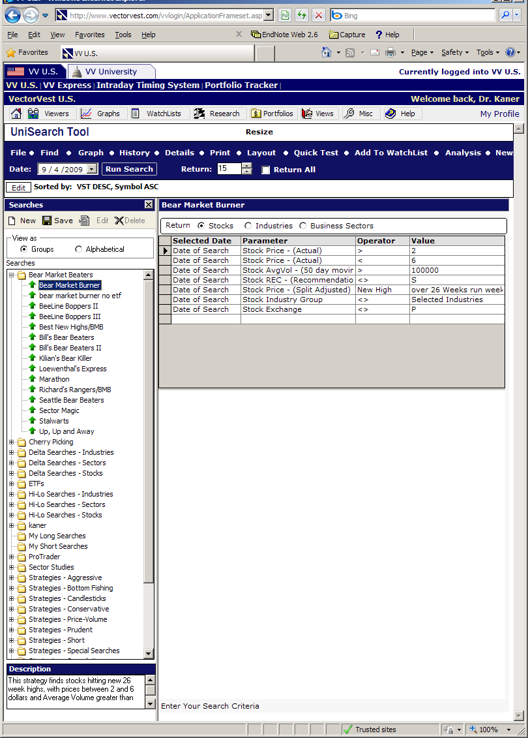
VectorVest Strategies
There are about 250 of these, tailored for different expectations about market performance.

Slide 105
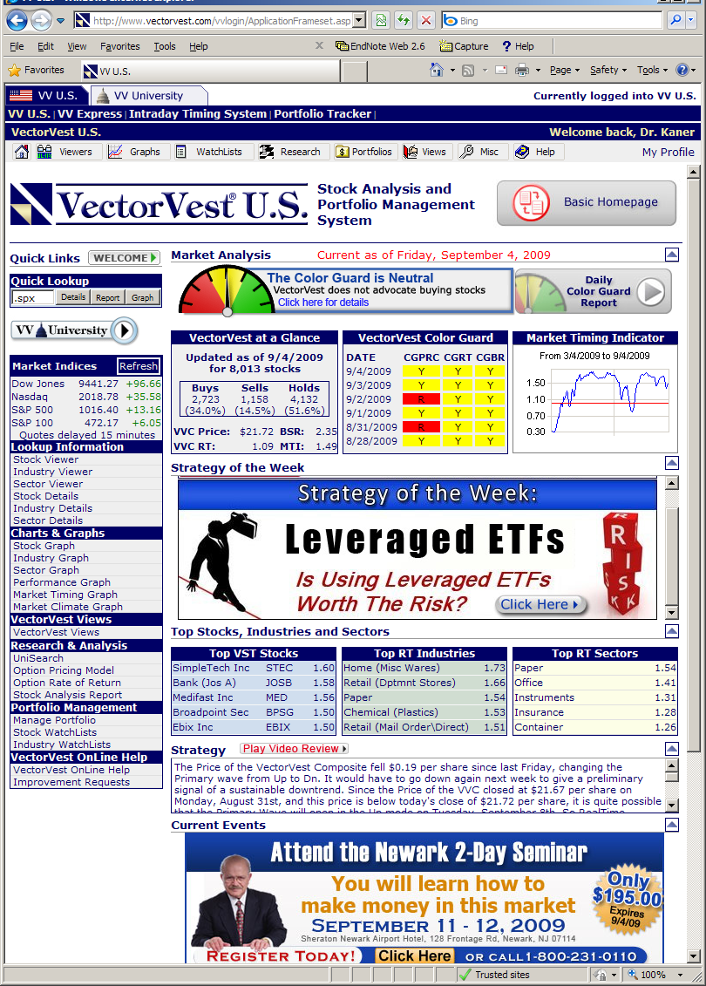
Strategy of the Week!
Suppose we sell a trading system with 250 strategies, and analyze the population every week to see which ones performed well.
What if all 250 were no better than a Motley-Fool dartboard? How many should perform statistically significantly better than the market?
(Answer -- 12.5, at the p <= .05 level of significance)

Slide 106
Hmm...
What should
we call the recommendations that didn’t make money?
Maybe we should do some research

Slide 107
Reports like this have been catching my attention: Goldman Sachs compensation: $1 mn per employee in sight
4 Jul 2009, 2105 hrs IST, REUTERS, http://economictimes.indiatimes.com/articleshow/4777281.cms?prtpage=1
NEW YORK: The average Goldman Sachs Group Inc employee is within striking distance of $1 million in compensation and benefits this year, just nine months after the bank received a $10 billion US government bailout. The figure will likely fuel criticism of the politically connected bank, especially amid the widening recession and rising unemployment. In addition to the bailout, Wall Street's biggest surviving securities firm also benefited from several other government schemes during the depths of last year's financial crisis.
Goldman on Tuesday said money set aside for pay surged 75 percent in the second quarter. Compensation and benefits costs were $6.65 billion, up 47 percent from the equivalent quarter in 2008.
Given a 16 percent reduction in staff from last year, to 29,400, the bank set aside an average $226,156 per employee in the second quarter, up from $129,200 in a year ago. If the quarterly figure is annualized, it comes to $904,624 per employee.

Slide 108
A Critical Distinction
People who create (or use) (or improve) technology to model the market are called "quants."
They are central to the business
The business bases its decisions on their work
People who write (or test) code are called "technicians"
Even if they are doing implementation for the quants
Their focus is on the generic tasks of development
Instead of the specialized tasks of the business
They are cheap, expendable, and outsourceable (but certifiable)

Slide 109
“COLOR GUARD” on the front page seems to be VectorVest's most unique and important feature. This box speaks to the overall timing of the market:
VVC Price is the average price of the vector vest composite (the 8013 stocks in the VV database). They use it as an index, like S&P or Dow Jones
VVC RT is the “relative timing” of the market. The market is on a rising trend for RT > 1 and a declining trend for RT < 1. Based on its published formula (ratios of random variables), I would expect this to have an odd probability distribution.

Slide 110
BSR is the ratio of the number of stocks rated buy to the number of stocks rated sell in the VV database – ignoring the number rated hold. Suppose VV puts “hold” ratings on 8008 stocks, a Buy rating on 4 and a sell rating on 1, I would think this is a flat market, but with a 4-to-1 ratio of buys to sells (ignore the 8008 holds), BSR would have a value of 4.0, a seemingly huge value.
MTI is the overall Market Timing Indicator and the is described in VectorVest tutorials as a key predictor in their system.

Slide 111
The color system is summary of trends over the past few days / few weeks.
According to VectorVest:
yellows mean there is no trend to follow,
red means the market is declining and you should NOT buy anything tomorrow, and
green means the market is rising and you feel good about buying.

Slide 112
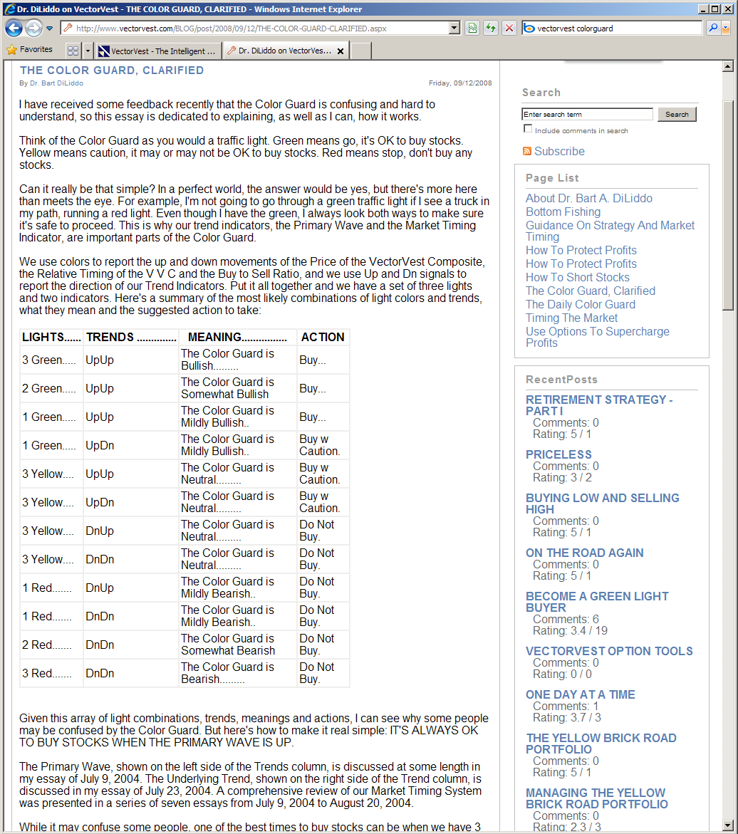
VectorVest in their own words

Slide 113
VectorVest in their own words
from ... THE COLOR GUARD, CLARIFIED
Bart DiLiddo (VectorVest founder)

Slide 114
A little research
To study the ColorGuard system as a predictor of the market, I downloaded Standard and Poors' S&P-500 index prices from January 4, 1999* through early Sept 2009.
I then computed percentage price changes:
percent gain or loss in the S&P compared to the current day
percent gain or loss between the current day value and the value 5 trading days from the current day.
after 15 trading days
after 30 trading days.
I also looked at 2-day, 3-day and 4-day for some analyses, but the results were the same as 1-day and 5-day so I stopped bothering.
The average day-to-day change in the market was 0.0027% (flat over 10 years)
* Available ColorGuard data appeared to start in late 1998

Slide 115
Results
Correlation between RT (relative timing) and future S&P index price was slightly negative (-0.034 for next-day price, -0.038 for 5-day, -0.019 for 15-day and 0.010 for 30-day).
The effect trends toward zero as you go further in the future (as a predictor of 30-days in the future). With over 2600 days of data, these tiny correlations are probably statistically significant, but it’s a tiny effect.
Correlation between Buy Sell ratio and future price is -0.012 for next-day, -0.011 for 5 day, 0.018 for 15 day and 0.032 for 30 day.
Like relative timing, as an indicator for short term trading decisions, this is at best, worthless.
Correlation between MTI and future price is -0.025 for next day,
-0.025 for 5-day (the same number is not a typo), -0.004 for 15 day and -0.016 for 30-day.
When these indicators predict “going up”,
the market on average goes slightly down.

Slide 116
A Few More Results
From 1999 to September 2009:
289 trading days rated GREEN / GREEN / GREEN (GGG) (buy)
285 rated RED / RED / RED (don't buy).
After GGG days, S&P index went DOWN an average of
-0.05% the day after a GGG rating,
-0.24% five days after,
-0.14% 15 days after, and
-0.33% 30 days after.
After RRR days, S&P went UP an average of
0.24% the day after an RRR,
0.29% five days after,
0.42% 15 days after and
1.08% in the 30 days after an RRR

Slide 117
Time to think about testing
Imagine these roles:
individual investor trying to avoid making terrible mistakes and losing all her retirement money
technical expert, hired by Securities & Exchange Commission to help them investigate stock-market related fraud
analyst helping an investment firm assess effectiveness of investment strategies
individual investor trying to assess effectiveness of investment-guidance tools that he is writing
analyst working at an investment firm that creates/sells investment-guidance tools:
writing the code
evaluating the usability and basic dependability of the product
evaluating the effectiveness of the product
These are all testing roles

Slide 118
Software testing
is an empirical
technical
investigation
conducted to provide stakeholders
with information
about the quality
of the product or service under test
We design and run tests in order to gain useful information about the product's quality.
Empirical? -- All tests are experiments.
Information? -- Reduction of uncertainty. Read Karl Popper (Conjectures & Refutations) on the goals of experimentation

Slide 119
Testing is always a search for information
Find important bugs, to get them fixed
Assess the quality of the product
Help managers make release decisions
Block premature product releases
Help predict and control product support costs
Check interoperability with other products
Find safe scenarios for use of the product
Assess conformance to specifications
Certify the product meets a particular standard
Ensure the testing process meets accountability standards
Minimize the risk of safety-related lawsuits
Help clients improve product quality & testability
Help clients improve their processes
Evaluate the product for a third party
Different information objectives require different testing tools and strategies and will yield different tests, different test documentation and different test results.

Slide 120
Three of the Commonplace Information Objectives for Investment Modeling
Develop a strategy that is likely to yield profits
Assess the profitability of one or more implementations (where "implementation" includes the strategy)
Verify that the code behaves predictably

Slide 121
Basic concepts
Let's define a "strategy" as a combination of decision rules:
what to buy
how much to buy
when to buy it
when to sell it
how much to sell
Many strategies require a human decision-maker applying human judgment.
Whether by person or machine, all decisions are made under uncertainty

Slide 122
Simplistic strategies
Buy in the early morning (market open), sell at market close (in a generally rising market)
(How do you know if you're in a generally rising market?)
Buy at close, sell the next morning (in a generally declining market)
Buy a stock when it drops more than D% in one day and sell it back when the stock regains ½ of its loss
Buy a stock when it hits a 52-week high and sell (a) after B% (e.g. 25%) rise or 10% trailing stop
These are probably all losers, but how can we tell?

Slide 123
Building a Model
start with a plausible hypothesis
in practice, this is the hardest step and the one that requires the most investigation
decide what data to test it on
get the data
what's the right test?
if the model proves itself wrong
study the fine grain of the data for evolution to next model
if model appears right
what replications are needed, on what data, to check this further?

Slide 124
1. Start with a plausible hypothesis
in practice, this is the hardest step and the one that requires the most investigation
For now, let's select this heuristic:
In a generally bullish period, buy at market open, sell at market close
(reflects market optimism?)

Slide 125
2. Decide what data to test it on
Should we test on individual stocks or an aggregate?
If individual, should we sample from a specific pool (e.g. Wireless Internet stocks (think iPhone) might behave differently from consumer stocks like Taco Bell)?
How should we select from the pool?
What time interval should we test on?
generally rising?
generally falling?
based on indicators (like consumer confidence)?
random?

Slide 126
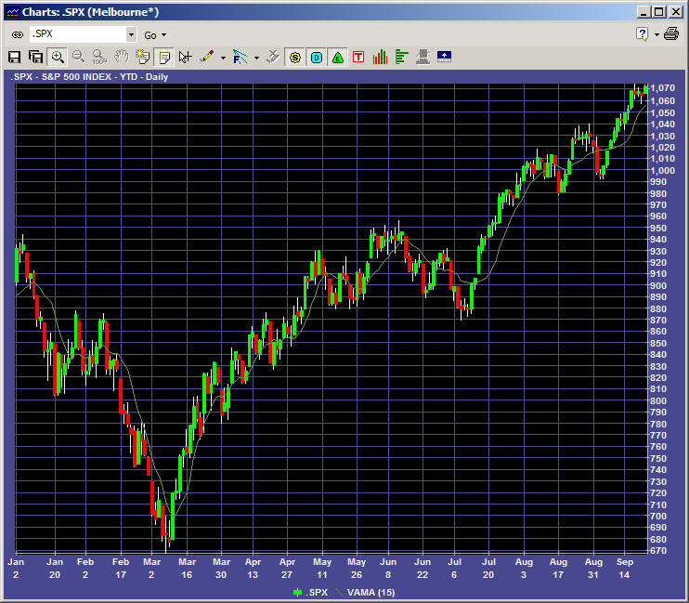
2. Decide what data to test it on
To simplify our example, let's choose the Standard & Poors index
from March 9 to present

Slide 127
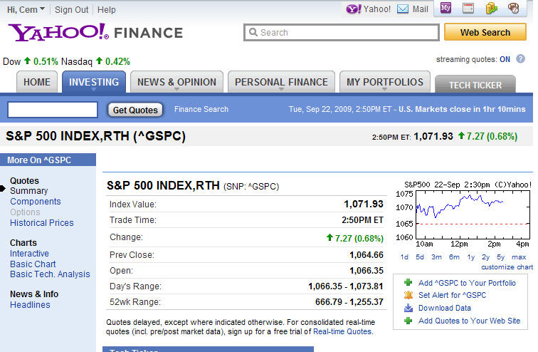
3. Get the data
In this case, getting the data is easy.
Yahoo has it.

Slide 128
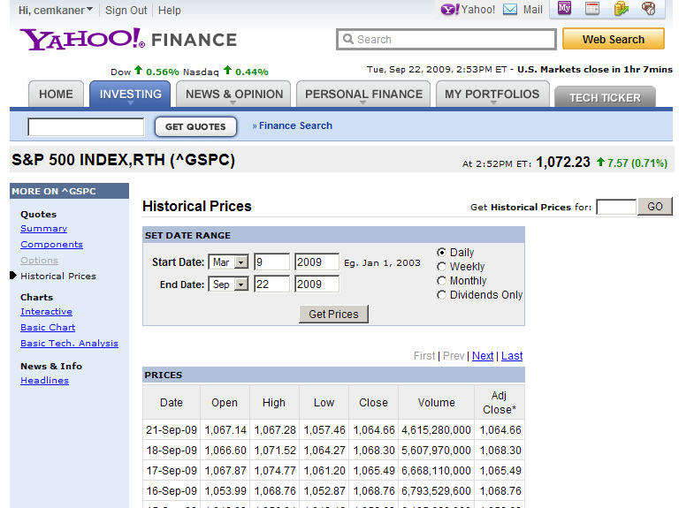
3. Get the data
But how do we know that it's right?
(This is a serious problem across different data sources. Examples in oral lecture.)
HOW DO WE GET THE DATA?

Slide 129
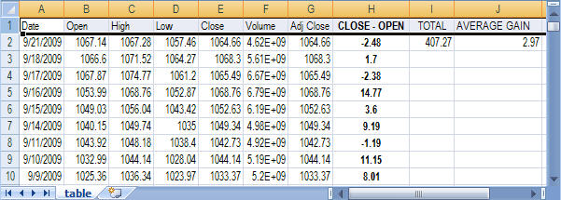
4. What's the right test?
My test is to calculate
delta = Closing index value - Opening index value
for every day in the time period
and then calculate average delta per day
Woo Hoo!!

Slide 130
5. If the model proves itself wrong
That didn't happen.
So we don't have to worry about it.
(yet)

Slide 131
6. If the model appears right
What replications are needed, on what data, to check this further?
Replications on rising markets in previous years?
Replications on falling markets?
Replications on broader market (S&P is a 500-stock subset of 15,500 stock market)
Replication across geographic segments (Chinese stocks? Israeli stocks? UK stocks?) (Do these add noise that should be chopped from our buying strategy?)
CAUTION: From my limited study, 2009 appears anomalous.
As far as I can tell, betting on this in the future is as likely to yield Boo Hoo as Woo Hoo.

Slide 132
1. But maybe we get a new hypothesis
Can we strengthen the predictable-rise-during-the-day hypothesis?
study the fine grain of the data
decide whether the hypothesis is wrong or incomplete
if incomplete:
vary conditions as (potentially) appropriate
If the underlying theory is a daily rise due to optimism
should we buy only when Consumer Confidence is up (we do have historical data)?
should we focus on stocks recently upgraded by analysts?
what else could enhance a general optimism, increasing its impact for a specific stock or industry or sector?
What if we tried EVERY variable?

Slide 133
Strategy
At the core of each strategy is this maxim:
Buy low
Sell high
The challenge is that we can know the current price, but not the price in the future.
How do we tell if a price is low,
relative to the price it will reach in the future?

Slide 134
Foundation of Many Strategies
select a stock based on its inherent value
select a buy rule based on its price momentum (do we think it's on the way up? buy buy buy !!! )
select a sell rule based on price momentum (do we think it's going down? sell sell sell !!! )
But how do we estimate inherent value?
Or perceived value?
Or momentum?

Slide 135
How do we estimate value?
Estimated value is a random variable
A strategy may do poorly empirically if estimated-value overestimates actual value
If we don't know the distribution of the estimator, how can we decide whether the success or failure of a transaction stemmed from:
poor model
poor relationship between our notion of "value" and future price
poor estimator
our concept of value is good, but we don't estimate it well
variability that resulted in a biased selection
our estimator is OK, but the underlying distributions are skewed and most trades will fail (lose money or gain too little)
poor timing
(e.g. bad luck) (e.g. overriding broad market trend)

Slide 136
How do we estimate the value?
VectorVest model: DiLiddo, Stocks, Strategies & Common Sense, p. 22
V = 100*(E/I)*SQR[(R+G)/(I+F)] where
V = stock value in $ per share
E = earnings per share in $ per share
I = AAA Corporate Bond Rate in percent
ROTC = Return on Total Capital in percent
R = I * SQR(ROTC/I)
G = Annual earnings growth rate in % per year
F = CPI inflation in % per year
How many random variables are here?
How many ratios of random variables?
What is the distribution of V?

Slide 137
What is the distribution of V?
Q: What's the big deal? Can't we just assume the distribution of V is "normal"?
A: You can assume anything you want, if you don't mind being wrong and losing all your money.

Slide 138
Why do we care about the distribution?
If V is a random variable:
How should we best estimate its central value?
mean? median? mode? Why?
The basic shape of the distribution (e.g. skew) is important for this
How can we decide whether an extreme-looking value is an "outlier" (a mistaken observation) or a legitimate datum that should be used in our calculations?
How can we decide whether a pattern of behavior is expected or unexpected?
How can we decide whether a change in stock price reflects simple random variation, or a change in underlying value?
In fact, studies of price distributions (even index prices) show thick tails, including (for individual stocks) frequent genuine price spikes (transient extreme values)

Slide 139
Ratios of Random Variables are Badly Behaved
In your statistics classes, you probably studied the distributions of sums of random variables, but not ratios
You probably worked with a ratio variable: the F distribution. Try to remember how oddly it was shaped.
Ratio variables often have
thick tails (distant-from-mean data that look like outliers)
skew
Good luck deriving the distribution
If we want to include distributional shapes or parameters in our models, we will probably have to get them via simulation.

Slide 140
Timing Variables
The first derivative of a function measures its rate of change in location (speed), for example how quickly the price changes
The second derivative measures its change in speed (acceleration). A simple linear function has no acceleration, just growth. A square (x^2) accelerates linearly. A logarithm is decelerating.
The third derivative measures rate of change of acceleration (jerk).
It's interesting to consider jerk as a way of looking at impact of analyst recommendations, earnings announcements and other events that happen relatively few times per year.

Slide 141
Distributions of Timing Variables?
Now, think about the timing variables:
If we measure change only with respect to time, rates of change seem like a relatively simple measure (except for nonstationarity).
It is common to derive the probability distribution of a function of a random variable, for example the distribution of the mean, the skew (symmetry), and the kurtosis (relative thickness of the tails) of the distribution
I'm not sure it's easy to derive the probability distribution for a random variable that derives its value from another random variable by being its derivative.
Additionally, we often measure change of a ratio (e.g. price to earnings) (price to book value), (growth to R&D expense)

Slide 142
Stationary Distributions
A random variable has a stationary distribution if its statistical properties (distributional shape and parameters) do not change over time.
Our variables are probably nonstationary (e.g. population-mean price probably changes over time)
Our variables might have mixture distributions (multiple distributions in play at the same time)
Our variables also often have high jerk values (3rd derivative, rate of change of acceleration) at predictable times (earnings announcements, dividend announcements, ratings announcements by key analysts)

Slide 143
Let's illustrate this with an example

Slide 144
Royal Bank of Scotland Preferred Series T
Preferred Stocks:
Owned by shareholders (like common stock), but usually nonvoting
Stock pays dividends at a (typically) fixed rate, comparable to paying interest on a debt
This is like debt except that the company doesn't have to pay it back
Dividends can be mandatory or discretionary
RBS-Preferred Series T (RBS+T or RBSPRT)
discretionary, $1.812 per year ($0.453 per quarter)
sold for $25
at $25, $1.812 is 7.25% interest
at $11.99, 1.812 is 15.11%
(a HUGE dividend if you think RBS is a survivor)

Slide 145
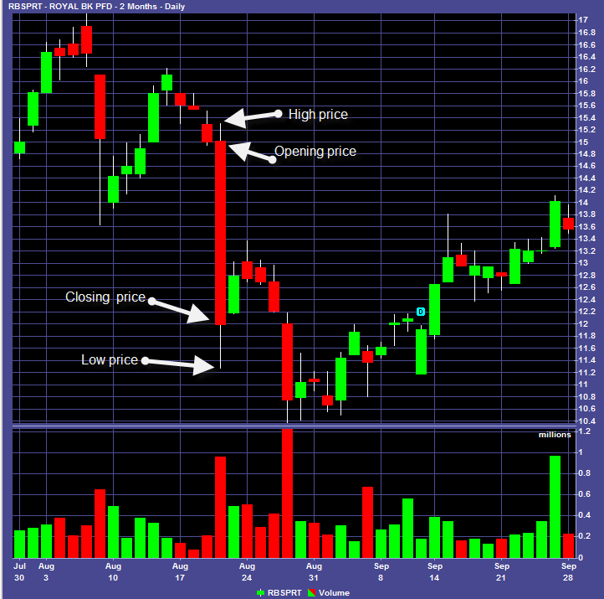
A candlestick chart for RBS/T
Prices on the top
Volume on the bottom
Shows:
High price for the day
Starting price
Ending price
Low price for the day
Bar is red if Start < End
This chart shows:
Royal Bank of Scotland Preferred stock, Series T
On August 20, 2009,
Opened at $15.01
High at $15.29
Low at $11.27
Closed at $11.99
On September 25
Closed at $14.02
Wouldn’t it be nice to
Buy at $11.99
and sell at $14.02?

Slide 146
RBS-T mean seems to vary over time (Nonstationary)

Slide 147
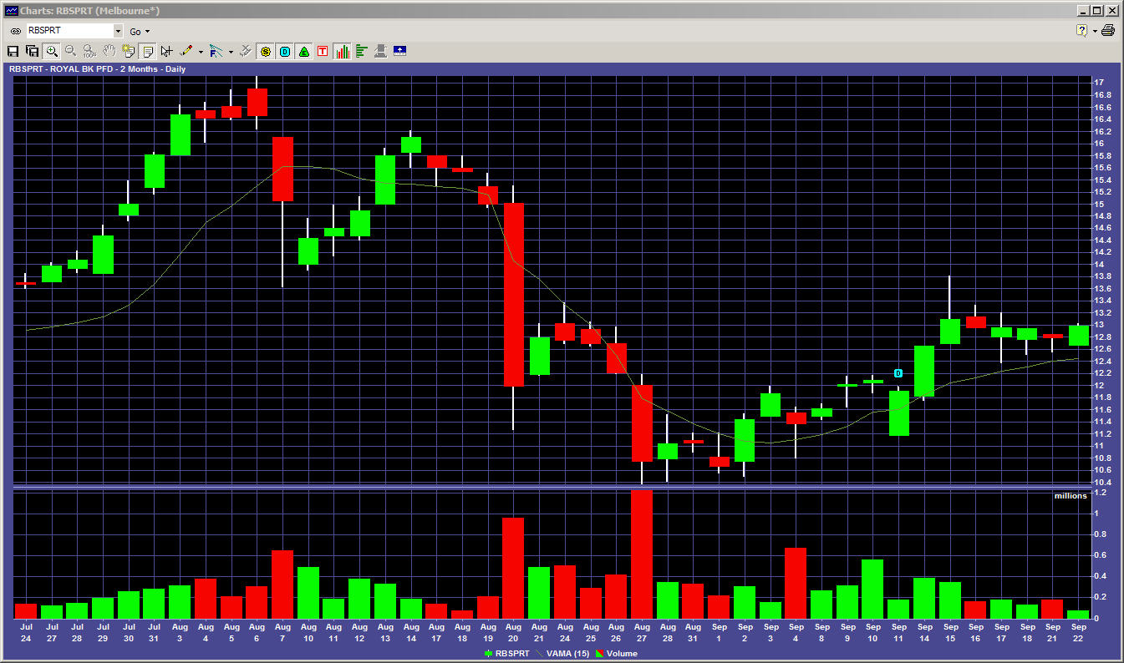
and has big changes that look nonrandom (high jerk)

Slide 148
The big drop on 8/20/09
Aug 20 - Fitch Ratings has downgraded the ratings of hybrid securities at Lloyds Banking Group plc (LBS), Royal Bank of Scotland Group plc (RBS), ING Group, Dexia Group, ABN Amro, SNS Bank, Fortis Bank Nederland and BPCE and certain related entities. The downgrade reflects increased risk of deferral of interest payments after the European Commission (the "Commission") clarified its stance on bank hybrid capital, and in particular the application of the concept of "burden-sharing". A full list of ratings actions is available at the end of this commentary.
The Commission's recent statements confirm Fitch's view that government support for banks may not extend to holders of subordinated bank capital (see 4 February 2009 comment "Fitch Sees Elevated Risk of Bank Hybrid Coupon Deferral in 2009" on www.fitchratings.com). Fitch has already taken significant rating actions on the hybrid capital instruments of ailing banks within the EU and elsewhere. Nevertheless, in the light of the latest Commission statements, Fitch is applying additional guidelines in its ratings of hybrid capital instruments issued by EU financial institutions. These are outlined in a report published today, entitled "Burden Sharing and Bank Hybrid Capital within the EU." A second report; "UK Banks and State Aid: "A Burden Shared", which is also published today, discusses the implications for bondholders of UK banks that have received state aid.
In particular, Fitch would highlight that a bank that has received state aid and is subject to a name-specific restructuring process will likely have a hybrid capital rating in the 'BB' range or below, with most ratings on Rating Watch Negative (RWN), indicating the possibility of further downgrades. Banks which Fitch believes are subject to significant state aid beyond broad-based confidence building measures will likely have a hybrid capital rating in the 'B' range or below, and be on RWN. Fitch will apply these guidelines to banks where a formal state aid process has not yet been established, but where Fitch believes such a process is likely to arise. ...
The securities affected are as follows: The Royal Bank of Scotland Group plc -- Preferred stock downgraded to 'B' from 'BB-' and remains on RWN (and a bunch of other banks)

Slide 149
Information inequity causes mixture distributions

Slide 150
Here's the Mixture (RBS 9/4/09)
I got this note from IB at 4 am on 9/4. This news didn't show up on the RBS site or at several brokerage or news sites until end of day or next day (or later).
So, some people were buying on the news that dividends are coming. Others selling because they thought dividends were not coming.

Slide 151
So how do we model this?
My preference is to look at the fine grain of the data, for interactions among several variables that :
haven't been studied well enough together (combine "fundamental" and "technical" variables)
are predictive under a narrower set of circumstances than all stocks (or all stocks in a sector) or at all times
We have hundreds of potentially available variables to work with.
Their values are all probabilistic
Some variables will be better predictors than others.

Slide 152
So how do we model this?
So, how do we:
decide which variables might be relevant?
assess their effectiveness as predictors?
distinguish between variability, covariation with other predictors, and irrelevance?
We can get historical data for many of these variables from the public web, larger collections from VectorVest (very detailed collection of historical data), Fidelity WealthLab (an awesome collection) and probably other sites.

Slide 153
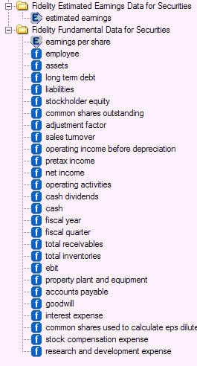
Variables Available in Fidelity WealthLab: You can find values for almost any point in time

Slide 154
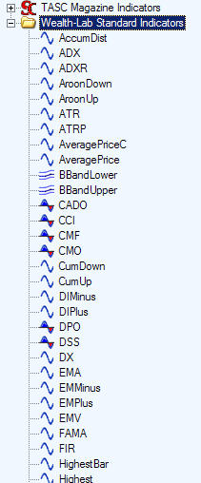
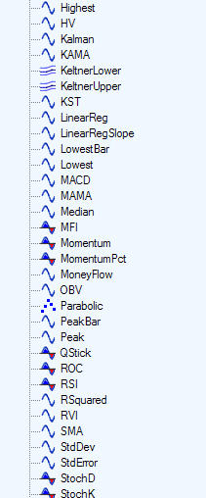
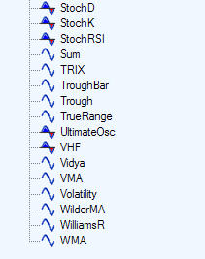
Variables You can calculate any delta over time or any delta of any ratio of these over time
Which should we look at?

Slide 155
Even more Wealth-Lab data

Slide 156
Random Choices
If we select individual stocks, should we select ALL of them or some?
If we want to check stratification across industries or sectors, should we compare all of them or some?
If we test across dates, should we select all of them or some?
If some, should we:
handpick each case?
lay out some criteria and sample randomly from them?
Beware of experimenter effects

Slide 157
Random Sampling
protects against biased selection of individual ranges of data or individual stocks
essential when dealing with historical data because you know what happened
provides a rationale for replication on "essentially the same" data set
allows computerized decision-making, i.e. rapid and automated selection, and then rapid replication
you certainly need that if you're going to check the covariation between delta(close-open)) and each of umptybuzzilion other variables

Slide 158
Remember: Probabilistic Overload
Suppose we identified 100 variables of interest, and tested each to see whether values of that variable had a statistically significant relationship with the trading opportunity that we're studying (delta (open-close)).
Parametric statistics are maybe not so good here (what are the distributions of the random variables of interest?), but there are plenty of distribution-free tests.
Suppose there really is no delta(open-close) effect.
How many variables should give us statistically significant predictive patterns?
(Answer: 5% at the p <= 0.05 level)

Slide 159
False Positives
Type 1 Error:
It looks like
a highly predictive variable
an awesome strategy
but it isn't
Type 2 Error:
It looks
completely unpredictive
a losing strategy
but we are missing the relationship that is actually there
Any screening study can yield
errors of both types.

Slide 160
Screening for predictive quality
Screening for predictive relationships is just screening, not proving.
If we want a heuristic good enough to bet our money on, I think we need
more extensive replication,
discovery of conditions under which the variable (or strategy) is ineffective, and
a rationale that allows us to make (and test) predictions that make sense.

Slide 161
The investment example
When we study "computing" as a general field (or software testing) (or software engineering) we often abstract away the underlying complexities of the subject matter we are working in.
A computer program is not just "a set of instructions for a computer." It is an attempt to help someone do something. The program:
makes new things possible, or
makes old things easier, or
helps us gain new insights, or
brings us new experiences (e.g. entertainment)
Programs provide value to companies
Some programs tie directly to the core value-generating or risk-mitigating activities in the company
Especially in organizations that see computing as a technology rather than as a goal in itself, your value to the organization rises if your work actively supports the business value of the software.

Slide 162
Investment example
Every evaluative step in this example involved testing
This work requires extensive technical knowledge, but
"technical" = the conceptually difficult areas in the business domain
"technical" ≠ programming
For years, the highest paid testers on Adobe Illustrator were graphic artists
For several years at WordStar, the most senior tester was a printer expert
Consider what testing you could do if you deeply understood:
actuarial mathematics (insurance risk modeling)
the technology (e.g. data mining) and psychology of customer relationship management and sales prospecting
taxation systems (e.g. as applied in employee compensation software)
airline reservation systems
the human factors of creative work (draw / video / text / music)

Slide 163
Now, Back to Automation
Many people get trapped in a mental box that says
"test automation Ξ automated execution of regression tests"
In previous talks, I've emphasized "high volume test automation" as applied to such areas as telephony, printer firmware and other embedded control systems, and assessment of mathematical computations.
Lots of test automation, but no regression testing
In this talk, we see testing as an analytic activity that helps the other stakeholders understand the subject matter domain (here, investing), the models they are building in it, and the utility of those models and the code that expresses them
Lots of test automation, but no regression testing
Rather than letting yourself get stuck in an overstaffed, underpaid, low-skill area of our field, it makes more sense to ask how, in this application's particular domain, we can use tools to maximize value and minimize risk.
High value test automation, probably not much regression testing.

Slide 164
Long sequence regression

Slide 165
A second case study: Long-sequence regression
Welcome to “Mentsville”, a household-name manufacturer, widely respected for product quality, who chooses to remain anonymous.
Mentsville applies wide range of tests to their products, including unit-level tests and system-level regression tests.
We estimate > 100,000 regression tests in “active” library

Slide 166
A second case study: Long-sequence regression
Long-Sequence Regression Testing (LSRT)
Tests taken from the pool of tests the program has passed in this build.
The tests sampled are run in random order until the software under test fails (e.g crash).
Note:
these tests are no longer testing for the failures they were designed to expose.
these tests add nothing to typical measures of coverage, because the statements, branches and subpaths within these tests were covered the first time these tests were run in this build.

Slide 167
Long-sequence regression testing
Typical defects found include timing problems, memory corruption (including stack corruption), and memory leaks.
Recent (2004) release: 293 reported failures exposed 74 distinct bugs, including 14 showstoppers.
Mentsville’s assessment is that LSRT exposes problems that can’t be found in less expensive ways.
troubleshooting these failures can be very difficult and very expensive
wouldn’t want to use LSRT for basic functional bugs or simple memory leaks--too expensive.

Slide 168
Long-sequence regression testing
LSRT has gradually become one of the fundamental techniques relied on by Mentsville
gates release from one milestone level to the next.
Think about testing the firmware in your car, instead of the firmware in Mentsville's devices:
fuel injectors, brakes, almost everything is computer controlled
for how long a sequence would you want to run LSRT's to have confidence that you could drive the car 5000 miles without failure?
what if your car's RAM was designed to be reset only after 100,000 miles, not when you turn the car off?

Slide 169
State models as a vehicle for long-sequence testing

Slide 170
Function equivalence testing

Slide 171
Function Equivalence Testing
Doug Hoffman worked for MASPAR (the Massively Parallel computer, 64K parallel processors).
The MASPAR computer has several built-in mathematical functions. We’re going to consider the Integer square root.
This function takes a 32-bit word as an input. Any bit pattern in that word can be interpreted as an integer whose value is between 0 and 2³²-1. There are 4,294,967,296 possible inputs to this function.
How many of them should we test?
How many would you test?

Slide 172
It's a life-critical system...
To test the 32-bit integer square root function, Hoffman checked all values (all 4,294,967,296 of them). This took the computer about 6 minutes to run the tests and compare the results to an oracle.
There were 2 (two) errors, neither of them near any boundary. (The underlying error was that a bit was sometimes mis-set, but in most error cases, there was no effect on the final calculated result.) Without an exhaustive test, these errors probably wouldn’t have shown up.
What about the 64-bit integer square root? How could we find the time to run all of these? If we don't run them all, don't we risk missing some bugs?

Slide 173
This tests for equivalence of functions, but it is less exhaustive than it looks
System
under
test
Program state, (and uninspected outputs)
Program state
System state
System state
Monitored outputs
Intended inputs
Impacts on connected devices / resources
Configuration and system resources
To cooperating processes, clients or servers
Cooperating processes, clients or servers
Program state
Program state, (and uninspected outputs)
System state
Reference
function
System state
Intended inputs
Monitored outputs
Configuration and system resources
Impacts on connected devices / resources
Cooperating processes, clients or servers
To cooperating processes, clients or servers

Slide 174
Can you specify your test configuration?
Comparison to a reference function is fallible. We only control some inputs and observe some results (outputs).
For example, do you know whether test & reference systems are equivalently configured?
Does your test documentation specify ALL the processes running on your computer?
Does it specify what version of each one?
Do you even know how to tell:
What version of each of these you are running?
When you (or your system) last updated each one?
Whether there is a later update?

Slide 175
Another example of function equivalence testing
Hoffman's work is described in his paper, Exhausting Your Testing Options, at http://www.softwarequalitymethods.com/H-Papers.html#maspar
Another instance of a bug that could have been found with this type of testing is Intel's Pentium FDIV bug (http://en.wikipedia.org/wiki/Pentium_FDIV_bug )

Slide 176
The Telenova simulator: probes as a vehicle for discovery

Slide 177
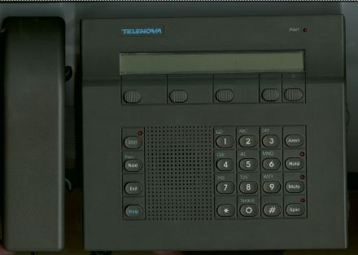
The Telenova Station Set
1984. First phone on the market with an LCD display.
One of the first PBX's with integrated voice and data.
108 voice features, 110 data features. accessible through the station set

Slide 178
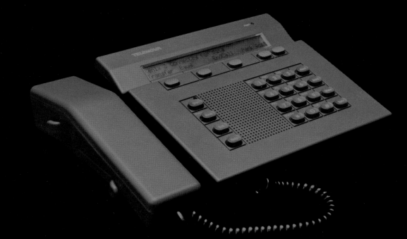
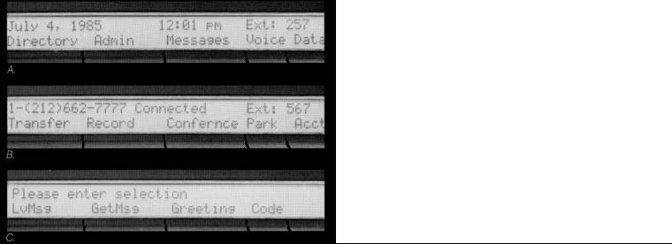
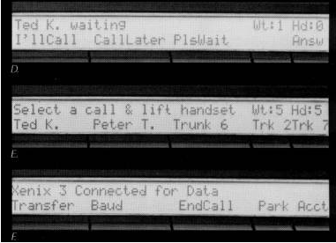
The Telenova stack failure
Context-sensitive display
10-deep hold queue
10-deep wait queue

Slide 179
Stack Failure
System allowed up to 10 calls on hold
Stored call-related data on a held-call stack
Under a rare circumstance, held call could be terminated but the stack entry not cleared
If the number of
calls actually on hold, plus
not-cleared terminated calls
exceeded 20
the phone rebooted due to stack overflow
In testing in the lab:
this bug never showed up even though testing achieved 100% statement and branch coverage in the relevant parts of the code (stack cleanup methods masked the error and usually avoided failure in the field from this bug)
In the field, this required a long sequence of calls to a continuously-active phone.
Failure was irreproducble unless you considered the last 1-3 hours of activity

Slide 180
The Telenova stack Failure -- A bug that triggered high-volume simulation
Beta customer (a stock broker) reported random failures
Could be frequent at peak times
An individual phone would crash and reboot, with other phones crashing while the first was rebooting
On a particularly busy day, service was disrupted all (East Coast) afternoon
We were mystified:
All individual functions worked
We had tested all lines and branches.
Ultimately, we found the bug in the hold queue
Up to 10 calls on hold, each adds record to the stack
Initially, the system checked stack whenever call was added or removed, but this took too much system time. So we dropped the checks and added these
Stack has room for 20 calls (just in case)
Stack reset (forced to zero) when we knew it should be empty
The error handling made it almost impossible for us to detect the problem in the lab. Because we couldn’t put more than 10 calls on the stack (unless we knew the magic error), we couldn’t get to 21 calls to cause the stack overflow.

Slide 181
The Telenova stack failure: A simplified state diagram showing the bug
Idle
Ringing
Caller
hangs up
You
hang up
Connected
On Hold

Slide 182
Idle
Ringing
Caller
hangs up
You
hang up
Connected
On Hold
When the caller hung up, we cleaned up everything but the stack. Failure was invisible until crash. From there, held calls were hold-forwarded to other phones, filling their held-call stacks, ultimately triggering a rotating outage.

Slide 183
Telenova stack failure
Having found and fixed
the hold-stack bug,
should we assume
that we’ve taken care of the problem
or that if there is one long-sequence bug,
there will be more?
Hmmm…
If you kill a giant cockroach in your kitchen,
do you
assume you’ve killed the last bug?
or do you
call the exterminator?

Slide 184
Simulator with probes
Telenova (*) created a simulator
generated long chains of random events, emulating input to the system’s 100 phones
could be biased, to generate more holds, more forwards, more conferences, etc.
Programmers added probes (non-crashing asserts that sent alerts to a printed log) selectively
can’t probe everything b/c of timing impact
(*) By the time this was implemented, I had joined Electronic Arts. This summarizes what colleagues told me, not what I personally witnessed.

Slide 185
Simulator with probes
After each run, programmers and testers tried to replicate failures, fix anything that triggered a message. After several runs, the logs ran almost clean.
At that point, shift focus to next group of features.
Exposed lots of bugs
Many of the failures probably corresponded to hard-to-reproduce bugs reported from the field.
These types of failures are hard to describe/explain in field reports

Slide 186
Telenova stack failure
Simplistic approaches to path testing can miss critical defects.
Critical defects can arise under circumstances that appear (in a test lab) so specialized that you would never intentionally test for them.
When (in some future course or book) you hear a new methodology for combination testing or path testing:
test it against this defect.
If you had no suspicion that there was a stack corruption problem in this program, would the new method lead you to find this bug?

Slide 187
Generalizing to an architecture

Slide 188
The Tasks of Test Automation
Theory of error
What kinds of errors do we hope to expose?
Input data
How will we select and generate input data and conditions?
Sequential dependence
Should tests be independent? If not, what info should persist or drive sequence from test N to N+1?
Execution
How well are test suites run, especially in case of individual test failures?
Output data
Observe which outputs, and what dimensions of them?
Comparison data
IF detection is via comparison to oracle data, where do we get the data?
Detection
What heuristics/rules tell us there might be a problem?
Evaluation
How decide whether X is a problem or not?
Troubleshooting support
Failure triggers what further data collection?
Notification
How/when is failure reported?
Retention
In general, what data do we keep?
Maintenance
How are tests / suites updated / replaced?
Relevant contexts
Under what circumstances is this approach relevant/desirable?

Slide 189
Theory of Error
Common programming problems that would be caught in good unit testing
Failure to conform to a specification
Failure to enable a desirable benefit
Computational errors
obvious
boundary cases
subtle
Communications problems
protocol error
their-fault interoperability failure
Resource unavailability or corruption, driven by
history of operations
competition for the resource
Race conditions or other time-related or thread-related errors
Failure caused by toxic data value combinations
that span a large portion or a small portion of the data space
that are likely or unlikely to be visible in "obvious" tests based on customer usage or common heuristics

Slide 190
Theory of Error: Function Equivalence Testing
Common programming problems that would be caught in good unit testing
Failure to conform to a specification
Failure to enable a desirable benefit
Computational errors
obvious
boundary cases
subtle
Communications problems
protocol error
their-fault interoperability failure
Resource unavailability or corruption, driven by
history of operations
competition for the resource
Race conditions or other time-related or thread-related errors
Failure caused by toxic data value combinations
that span a large portion or a small portion of the data space
that are likely or unlikely to be visible in "obvious" tests based on customer usage or common heuristics

Slide 191
Theory of Error: LSRT, Telenova
Common programming problems that would be caught in good unit testing
Failure to conform to a specification
Failure to enable a desirable benefit
Computational errors
obvious
boundary cases
subtle
Communications problems
protocol error
their-fault interoperability failure
Resource unavailability or corruption, driven by
history of operations
competition for the resource
Race conditions or other time-related or thread-related errors
Failure caused by toxic data value combinations
that span a large portion or a small portion of the data space
that are likely or unlikely to be visible in "obvious" tests based on customer usage or common heuristics

Slide 192
Theory of Error
Common programming problems that would be caught in good unit testing
Failure to conform to a specification
Failure to enable a desirable benefit
Computational errors
obvious
boundary cases
subtle
Communications problems
protocol error
their-fault interoperability failure
Resource unavailability or corruption, driven by
history of operations
competition for the resource
Race conditions or other time-related or thread-related errors
Failure caused by toxic data value combinations
that span a large portion or a small portion of the data space
that are likely or unlikely to be visible in "obvious" tests based on customer usage or common heuristics

Slide 193
The Tasks of Test Automation
Theory of error
What kinds of errors do we hope to expose?
Input data
How will we select and generate input data and conditions?
Sequential dependence
Should tests be independent? If not, what info should persist or drive sequence from test N to N+1?
Execution
How well are test suites run, especially in case of individual test failures?
Output data
Observe which outputs, and what dimensions of them?
Comparison data
IF detection is via comparison to oracle data, where do we get the data?
Detection
What heuristics/rules tell us there might be a problem?
Evaluation
How decide whether X is a problem or not?
Troubleshooting support
Failure triggers what further data collection?
Notification
How/when is failure reported?
Retention
In general, what data do we keep?
Maintenance
How are tests / suites updated / replaced?
Relevant contexts
Under what circumstances is this approach relevant/desirable?

Slide 194
Input data How will we select & generate input & and conditions?
Selection of values to test
Generation of test inputs
single items or combinations of variables
managing combinatorial explosion
managing data dependencies
theory of selection
cover the data space (via sampling)
mitigate hypothesized risks
match usage profile(s)
approach to sampling
exhaustive?
random sample (plus edges?)
interval sample (with edges?)
stratified random sample
historical actual data
what dimensions do we generate
timing (time between different parts of the input)
movements (e.g. mouse gestures when drawing)
sequence of subtasks
edits
final input value
how do we generate them
capture human activity
capture activity and then vary parameters algorithmically
create the data algorithmically

Slide 195
Sequential dependence: Should tests be independent? If not, what info should persist or drive sequence from test N to N+1?
independence
does the automaton enforce this via clean-up algorithms
flow of control
e.g. state-transition testing. Every test is the precursor to state transition to the next.
what is the underlying model, how is validated against the software, how maintained, and is failure to reach the next state detected as a bug?
dirty system
Test N does not clean up before Test N+1 (like real use--you don't reboot a printer after each print job)
how do we monitor the state of the system after Test N?

Slide 196
Execution: How well are test suites run, especially in event of individual test failures?
What is the test execution framework
how do you add / subtract new tests
how do you know what you have, and have run
simple execution of linear script or a general-purpose interpreter that supports reusable methods
response to failure: log / clean-up / continue?

Slide 197
Output data: Observe which outputs & what dimensions of them?
Which outputs will we observe?
(Remember Hoffman's lesson--every test generates an unmanageably large set of results, so we choose what we look at.)
Which dimensions of each output
Which invisibles do we make visible?
Testability = visibility + control
Which internal states does our technology allow us to examine?

Slide 198
Comparison data: IF detection is via comparison to oracle data, where do we get the data?
Historical results
actual behavior of a previous test
Values computed by a human judge and stored for reference
Values computed from a reference program
Values computed from a model
Values computed from a simulation
Value acceptable-ranges computed from model / etc.

Slide 199
Detection What heuristics/rules tell us there might be a problem?
Comparator (processor of comparison data)
Comparator (processor of a model, such as evaluating a rule or heuristic that output X should not exceed output Y)
Diagnostic message (including exception or log output of a probe) caught by automaton
Unacceptable behavior
Usually-unacceptable behavior that needs further evaluation
Unexpected or improbable behavior

Slide 200
Evaluation: How do we decide whether X is a problem or not?
Are known errors dealt with by modifying a failing test so that it no longer interferes with the test run, or does the test generate the equivalent of an exception that can be checked against a list of known failures (and that serves as a central point for update when bugs are allegedly fixed)
Under what circumstances is a behavior determined to be a definite fail?
Does execution halt to support troubleshooting?
Does execution repeat to demonstrate reproducibility?
Is the default assumption that suspect behavior is probably a fail?
What of the maybe-it-failed tests? How are they processed?

Slide 201
Troubleshooting support Failure triggers what further data collection?
What state information (system / program / data) is known at the start of the test? Is it available on failure?
What state information can be collected on failure?
To what extent does collection of information item X change what we will learn when we look at item Y (Heisenberg applied to testing)
What diagnostics are triggered by failure
Automated replication?
Automated replication with parametric variation? (is this something that can be requested for difficult bug?)
Is longer-sequence history relevant / available?

Slide 202
Notification How/when is failure reported?
halt and wait for a human to check on status
sound alarm
automatic email to the owner of the test run or of the code (or other interested parties)?
automatic bug report?
attachments include dump of ... ???

Slide 203
Retention In general, what data do we keep?
What data?
Why do we keep it?
status information
what tests / what results / when run
what results per test across what version
how many bugs this iteration
failure logs and supporting data
configuration logs for each test run (enable evaluation of why an existing bug didn't show up in previous test)
for external review
process auditors
litigation support
buyer of product
buyer of development company
for status reporting
for troubleshooting support
for technical support (failure / success data)
for marketing support (e.g. examples of demonstrator scenarios that work)

Slide 204
Maintenance How are tests / suites updated / replaced?
Mechanism for updating tests
rewrite the entire test?
rewrite methods that map to program behavior that changed
revise stored data
How often is maintenance needed
how fragile are the underlying models
how fragile is the test code / documentation
Define "inertia" as opposite to agile "velocity". What is the inertia caused by the test suite / tool?

Slide 205
Relevant contexts: Under what circumstances is this approach relevant/desirable?
Suitable staff for development / maintenance of tests?
Timeframe for development (e.g. 6 weeks before release is unsuitable for test tool that needs 3 months of work)
Timeframe for recovery of automation-development and automation-maintenance costs
Appropriate assumptions of stability of code / design / platform, etc.
Extent to which the testing requirements are managed by adding this testing

Slide 206
More examples

Slide 207
Ten Examples of High Volume Automated Tests
Simulator with probes
Long sequence regression testing
Function equivalence testing (comparison to a reference function)
Comparison to a computational or logical model
Comparison to a heuristic prediction, such as prior behavior
State-transition testing without a state model (dumb monkeys)
State-transition testing using a state model (terminate on failure rather than after achieving some coverage criterion)
Functional testing in the presence of background load
Hostile data stream testing
Random inputs to protocol checkers
See Kaner, Bond, McGee, www.kaner.com/pdfs/highvolCSTER.pdf

Slide 208
Summary & conclusions

Slide 209
Closing Thoughts
Many people in our field are trapped in commodity roles:
The style of testing often promoted as "professional" is adversarial, inefficient, relatively unskilled, and easy to outsource
The style of test automation most often promoted is automated execution of regression tests, which are narrow in scope, redundant with prior work
Especially in difficult economic times, it is important for:
testers to ask how they differentiate their own skills, knowledge, attitudes and techniques from commodity-level testers
test clients to ask how they can maximize the value of the testing they are paying for, by improving their focus on the problems most important to the enterprise
In this talk, we look at testing as an analytic activity that helps the other stakeholders understand the subject domain (here, investing), the models they are building in it, and the utility of those models and the code that expresses them. We see lots of test automation, but no regression testing.
Rather than letting yourself get stuck in an overstaffed, underpaid, low-skill area of our field, it makes more sense to ask how, in your application's particular domain, you can use tools to maximize value and minimize risk.

Slide 210
References

